Slide 1
Spatial Evolution of Solar Wind Discontinuities in the Outer Heliosphere: JUNO and 1AU-missions Observations
Zijin Zhang Anton V. Artemyev Vassilis Angelopoulos

Slide 2
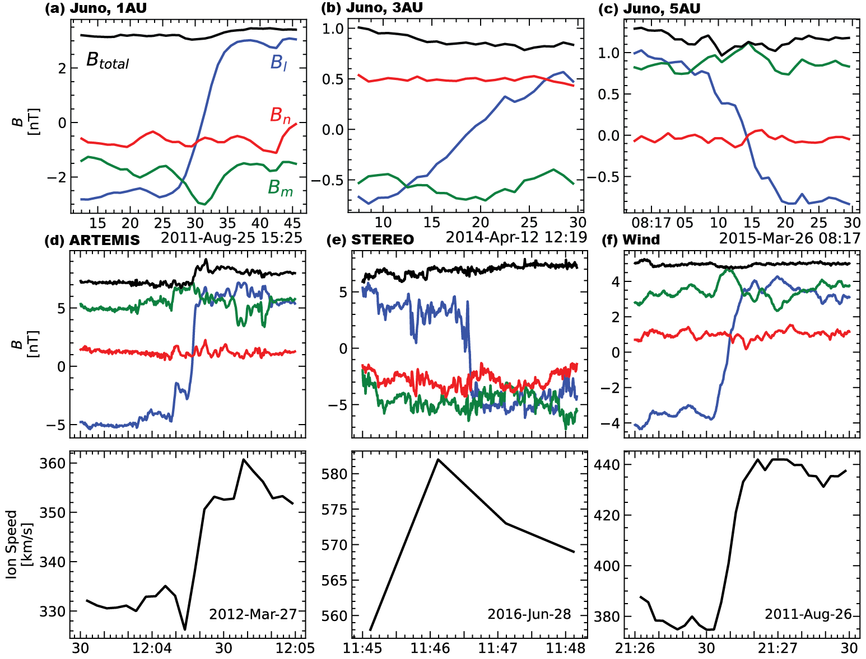
Introduction
Figure 1: Examples of IDs from ARTEMIS, STEREO, and Wind

Slide 3
Motivation
How do solar wind discontinuities evolve over radial distances from the Sun?
Juno during its five-year cruise phase (2011-2016) to Jupiter provides a unique opportunity!
=> What are the physical mechanisms behind their formation and evolution?

Slide 4
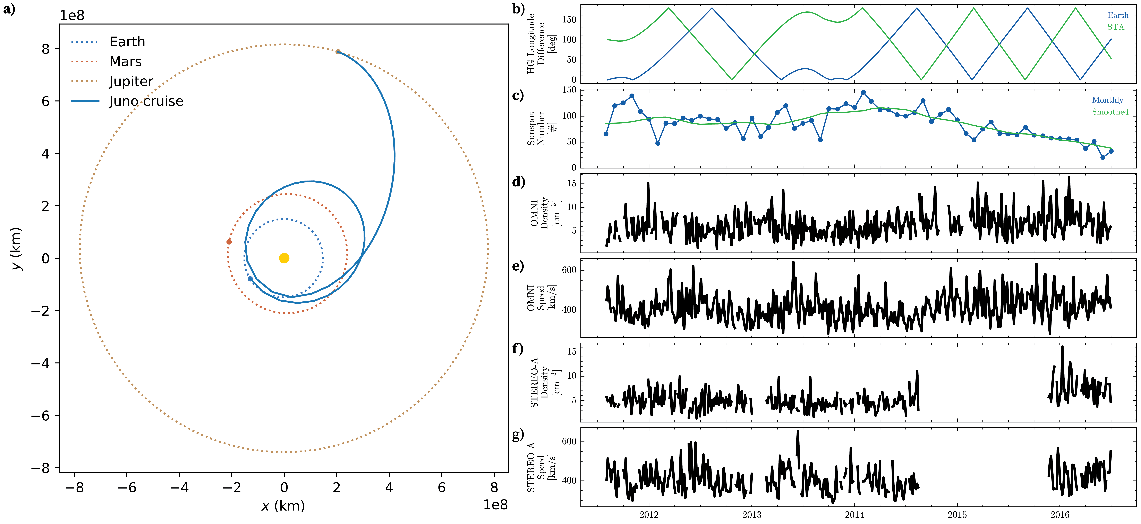
Overview
Figure 2: Overview. a, Juno’s orbit during its cruise phase (2011-2016). b, Difference in heliographic longitude between Juno and 1-AU missions. c, monthly and smoothed sunspot numbers. d-g, solar wind plasma density and speed from Near-Earth (OMNI) and STEREO-A missions.

Slide 5
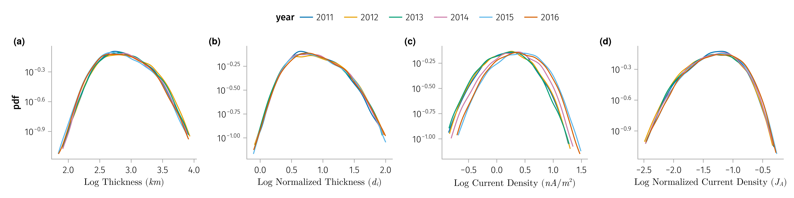
Temporal variations of SWDs
Figure 3: Distribution of various properties of IDs observed by Wind mission grouped by the year of observation. Panel (a) thickness, (b) normalized thickness, (c) current density, (d) normalized current density.

Slide 6
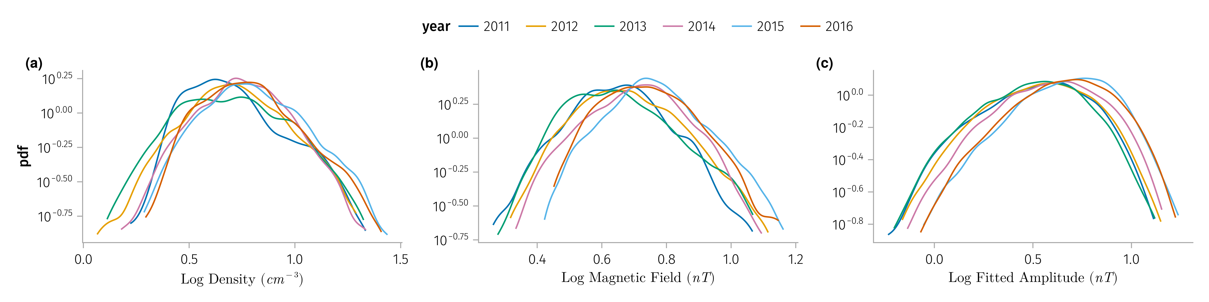
Figure 4: Solar wind parameters associated with the IDs observed by 1AU satellites (Wind, ARTEMIS and STEREO-A) grouped by the year of observation. Panel (a) solar wind density, (b) magnetic field, (c) fitted magnetic field $A$ in Equation 1.

Slide 7
Dataset
Mission | δt(B) | δt(plasma)
Juno | 1 Hz | 1 hour
ARTEMIS | 5 Hz | 0.25 Hz
WIND | 11 Hz | 1 Hz
STEREO | 8 Hz | 1 min

Slide 8
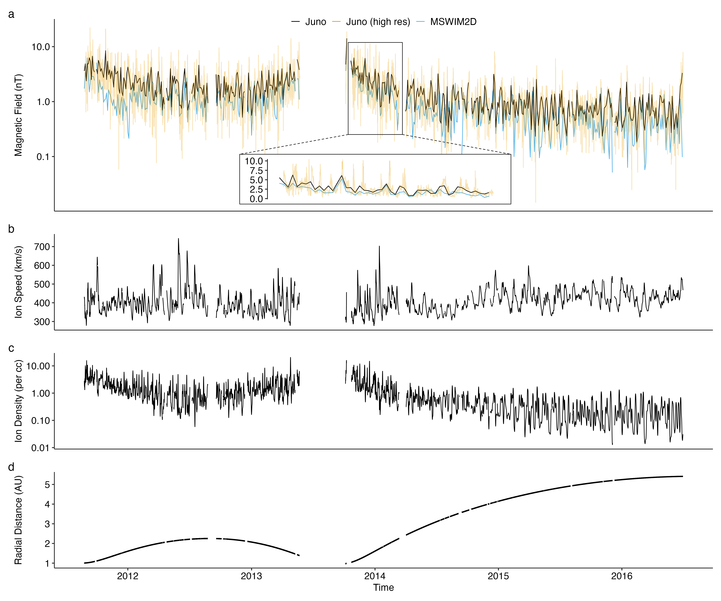
$$B\left(t;A,μ,σ,form=logistic\right)=A\left[1−\frac{1}{1+e^{α}}\right] \left(1\right)$$
Figure 5: a, Magnetic field magnitude from MSWIM2D and Juno. b-c, Plasma speed and density from MSWIM2D model. d, Juno radial distance from the Sun.

Slide 9
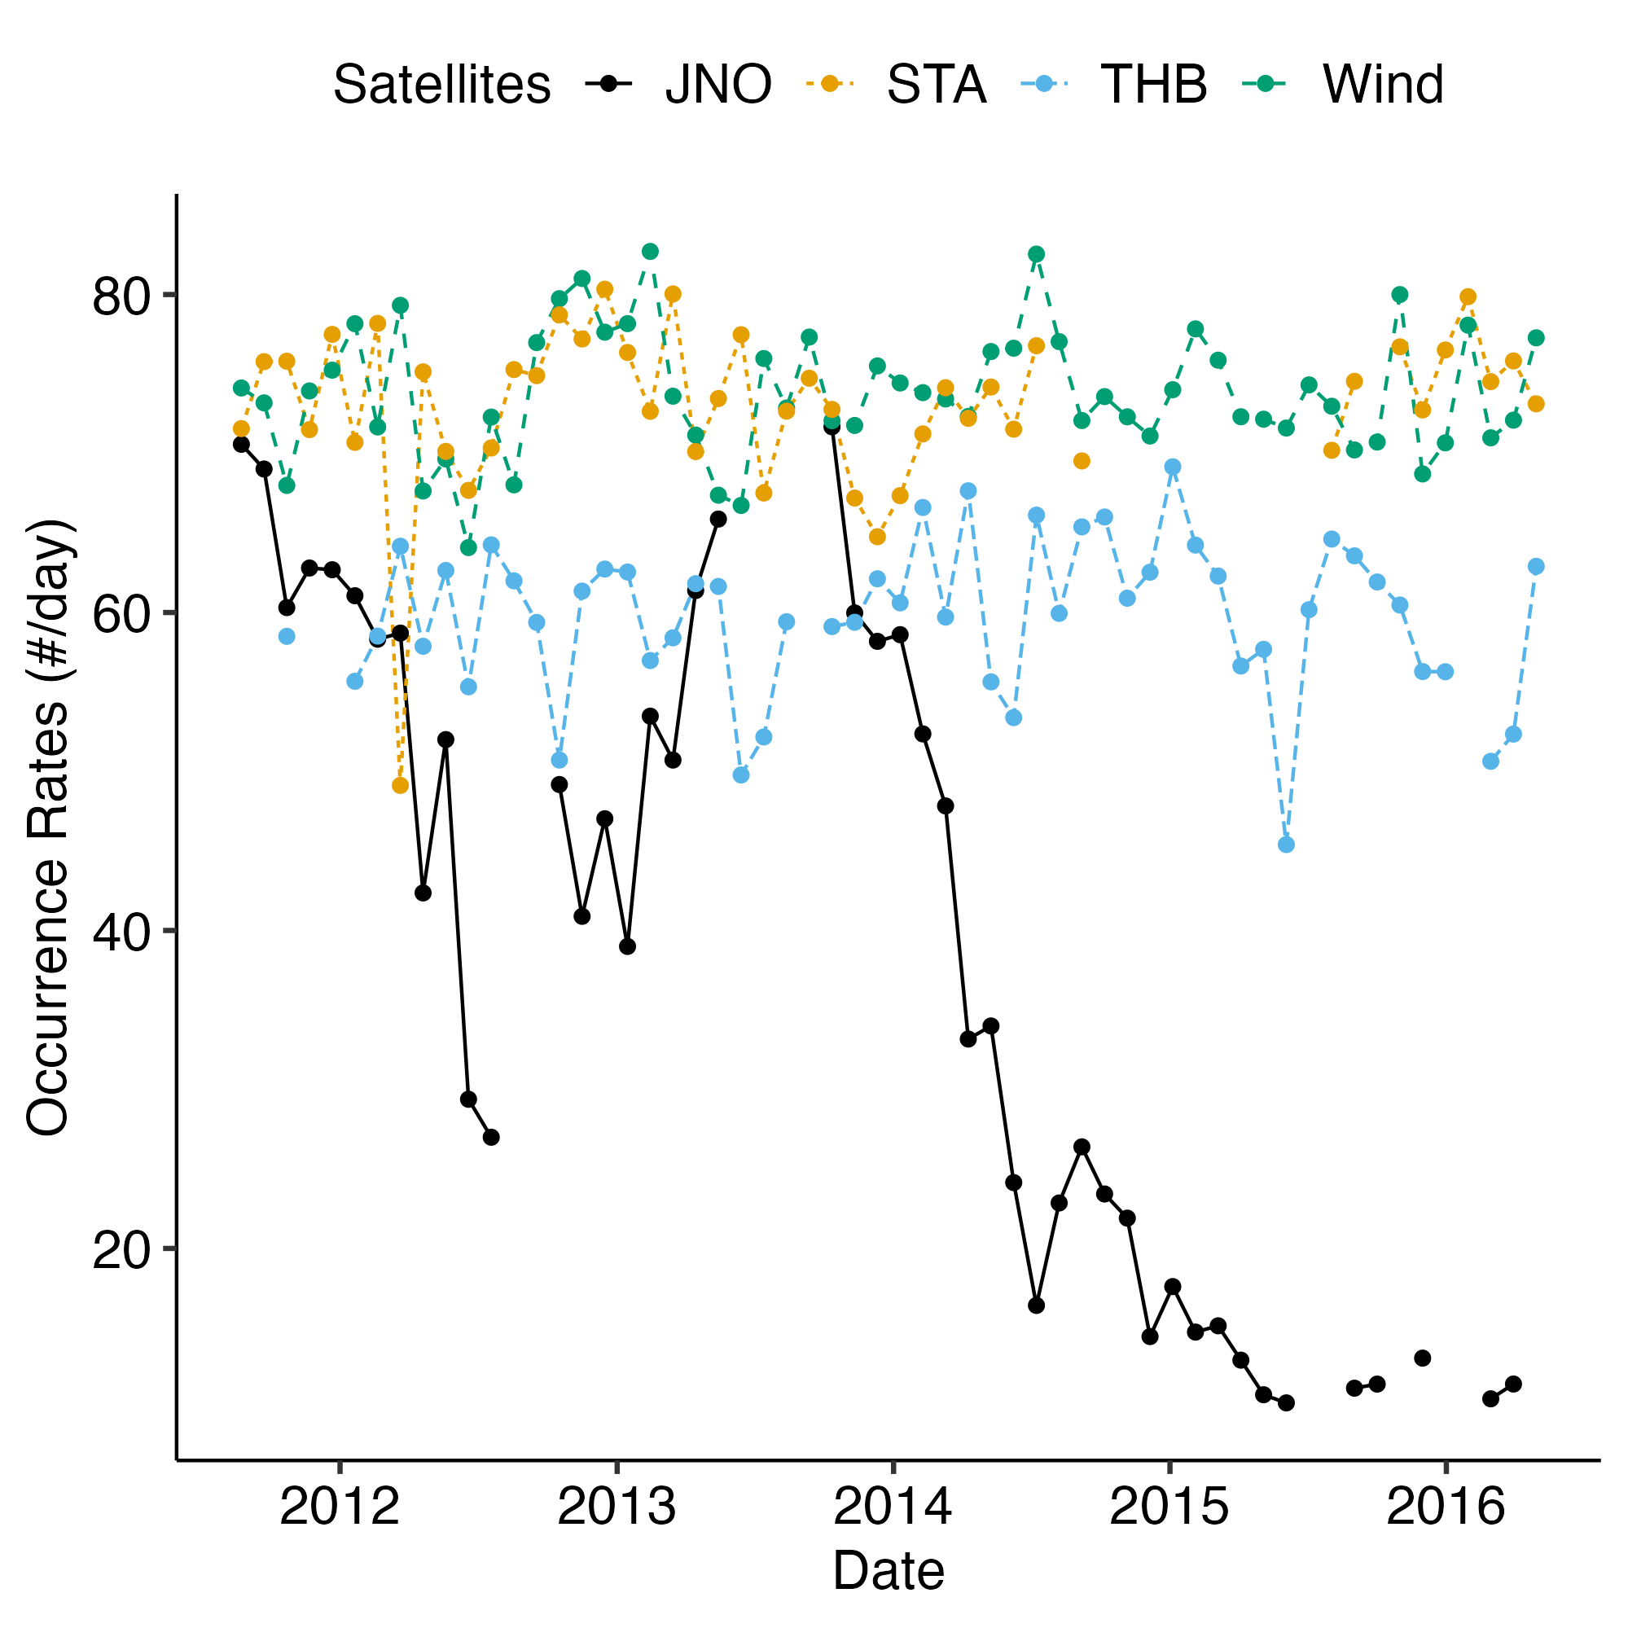
Results - Occurrence rate
Figure 6: The number of discontinuities measured by Juno per day coincides with the discontinuity number measured by STEREO, WIND, and ARTEMIS, when Juno is around $1$ AU. This number (occurrence rate) decreases with distance (with time after $∼2013$), as Juno moves from $1$ AU to $5$ AU. We will use the similar comparison for discontinuity characteristics and occurrence rate derived for PSP and Juno. The radial distance of Juno for 2011-2016 is shown in Figure 5.

Slide 10
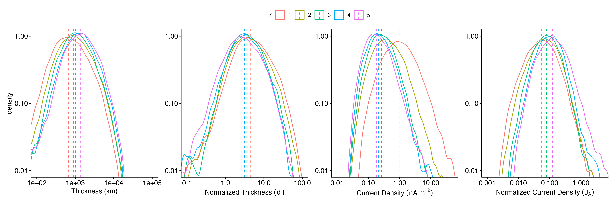
Results - Current density and thickness
Figure 7: Distribution of various properties of IDs observed by Juno grouped by the radial distance from the Sun. Panel (a) thickness, (b) normalized thickness, (c) current density, (d) normalized current density.

Slide 11
Conclusion
The normalized occurrence rate of interplanetary discontinuities (IDs) decreases with radial distance from the Sun, following a $1/r$ relationship.
The thickness of IDs increases with radial distance, but when normalized to the ion inertial length, the thickness decreases.
The current density of IDs decreases with radial distance, but when normalized to the Alfvén current, the current density of IDs increases.
The distribution of the normalized thickness and current density of IDs remain constant over time at 1 AU on a yearly scale.

